Slide 1
Projects
Remote Sensing + Data Sciences

Slide 2
BD-SAT: High-resolution Land Use Land Cover Dataset & Benchmark Results for Developing
Center for Computational and Data Sciences (CCDS), IUB

Slide 3
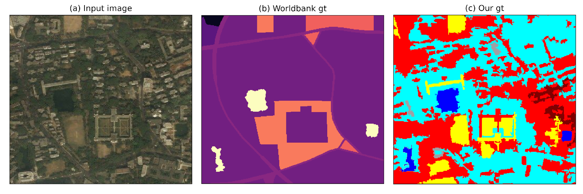
Motivation
Provide an accurate and reliable dataset (pixel by pixel annotation) for LULC – usable for deep learning for Bangladesh
Free Sentinel data (low resolution) vs Bing/Google data (High resolution)
Examine how channel combination from sentinel images with early and late multi-spectral fusion impact the segmentation tasks.

Slide 4
Data Collection
Data Location: Mostly Dhaka Division.
N24°23’04”, E89°57’26” (Upper Left corner)
N23°22’13”, E91°00’26” (Lower Right).
Data Source: Here two different data source has been used.
Bing: date of the Bing image is April 20, 2019.
Resolution: 48906x47256 pixels
2.22 meters/pixel
Sentinel-2A: data with tile number ”T45QZG” and tile IT45QZGA01617520190411T043829” was collected.
The Acquisition start date was 019-04-11T04:38:29.547Z
Notes:
what is the source of bing images? at what frequency is it updated? I do not understand the date. Answer: We download the bing image on this date. It is downloaded from Bing map. However, no information is provided when the image was uploaded or capture.

Slide 5
Full Bing image and the ground truth of Dhaka region

Slide 6
Annotation Process and Data Reliability
Three steps
Initial annotation process
Stage-1: Group-1 vs Group-2 annotation agreement/disagreement
Intermediate Annotation Process
Stage-2: Group-1 vs Group-2 annotation agreement/disagreemen
Final Annotation
Expert annotation

Slide 7
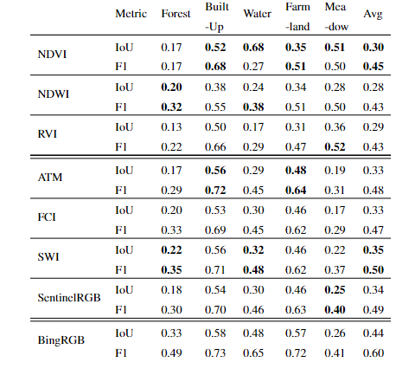
Performance Analysis with Deep Lab V3+

Slide 8
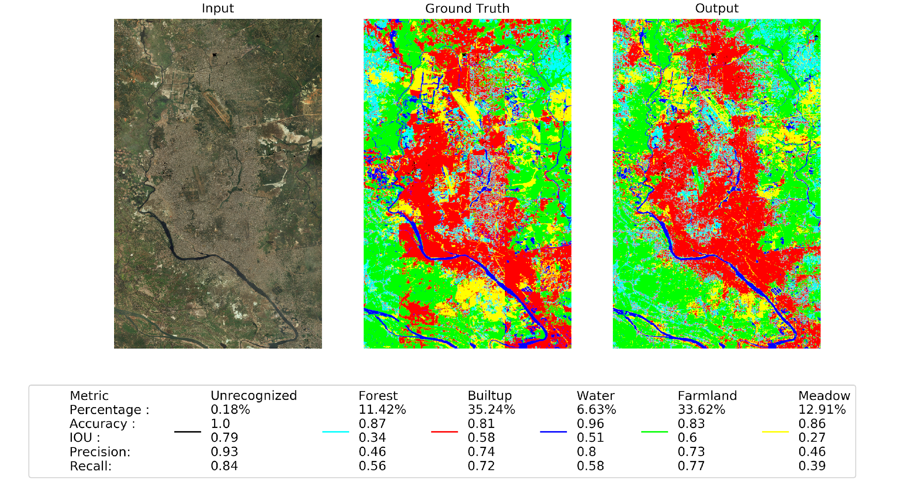
Results

Slide 9
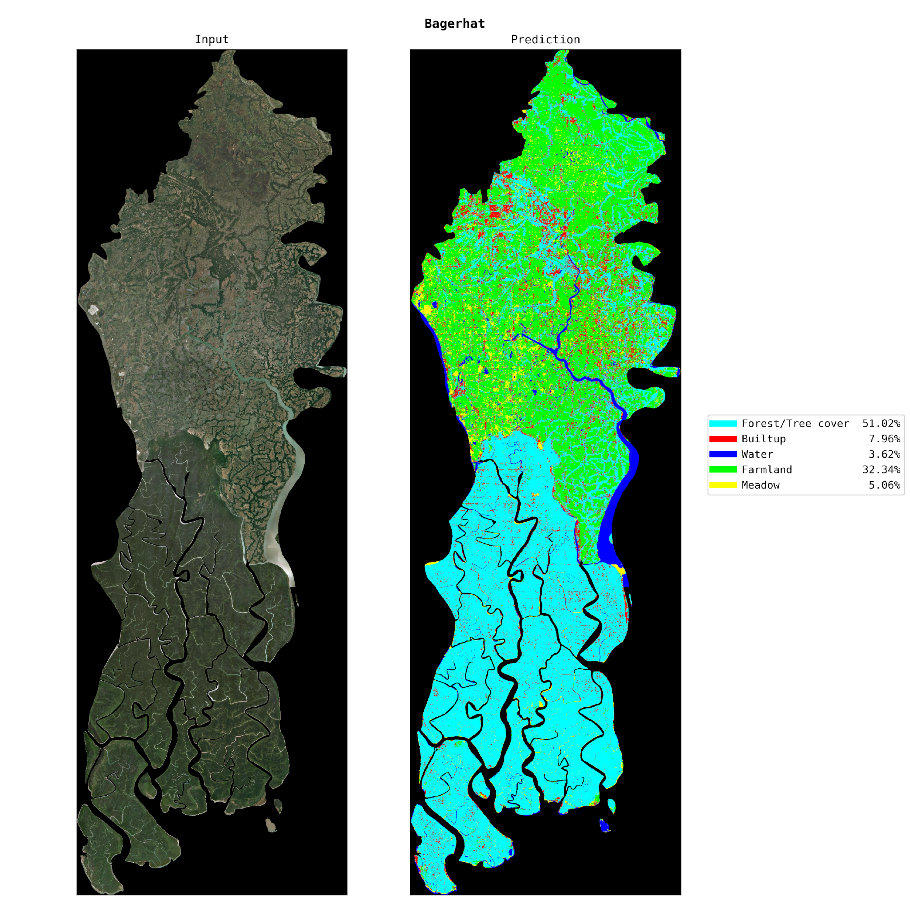
Automatic LULC on 64 districts

Slide 10
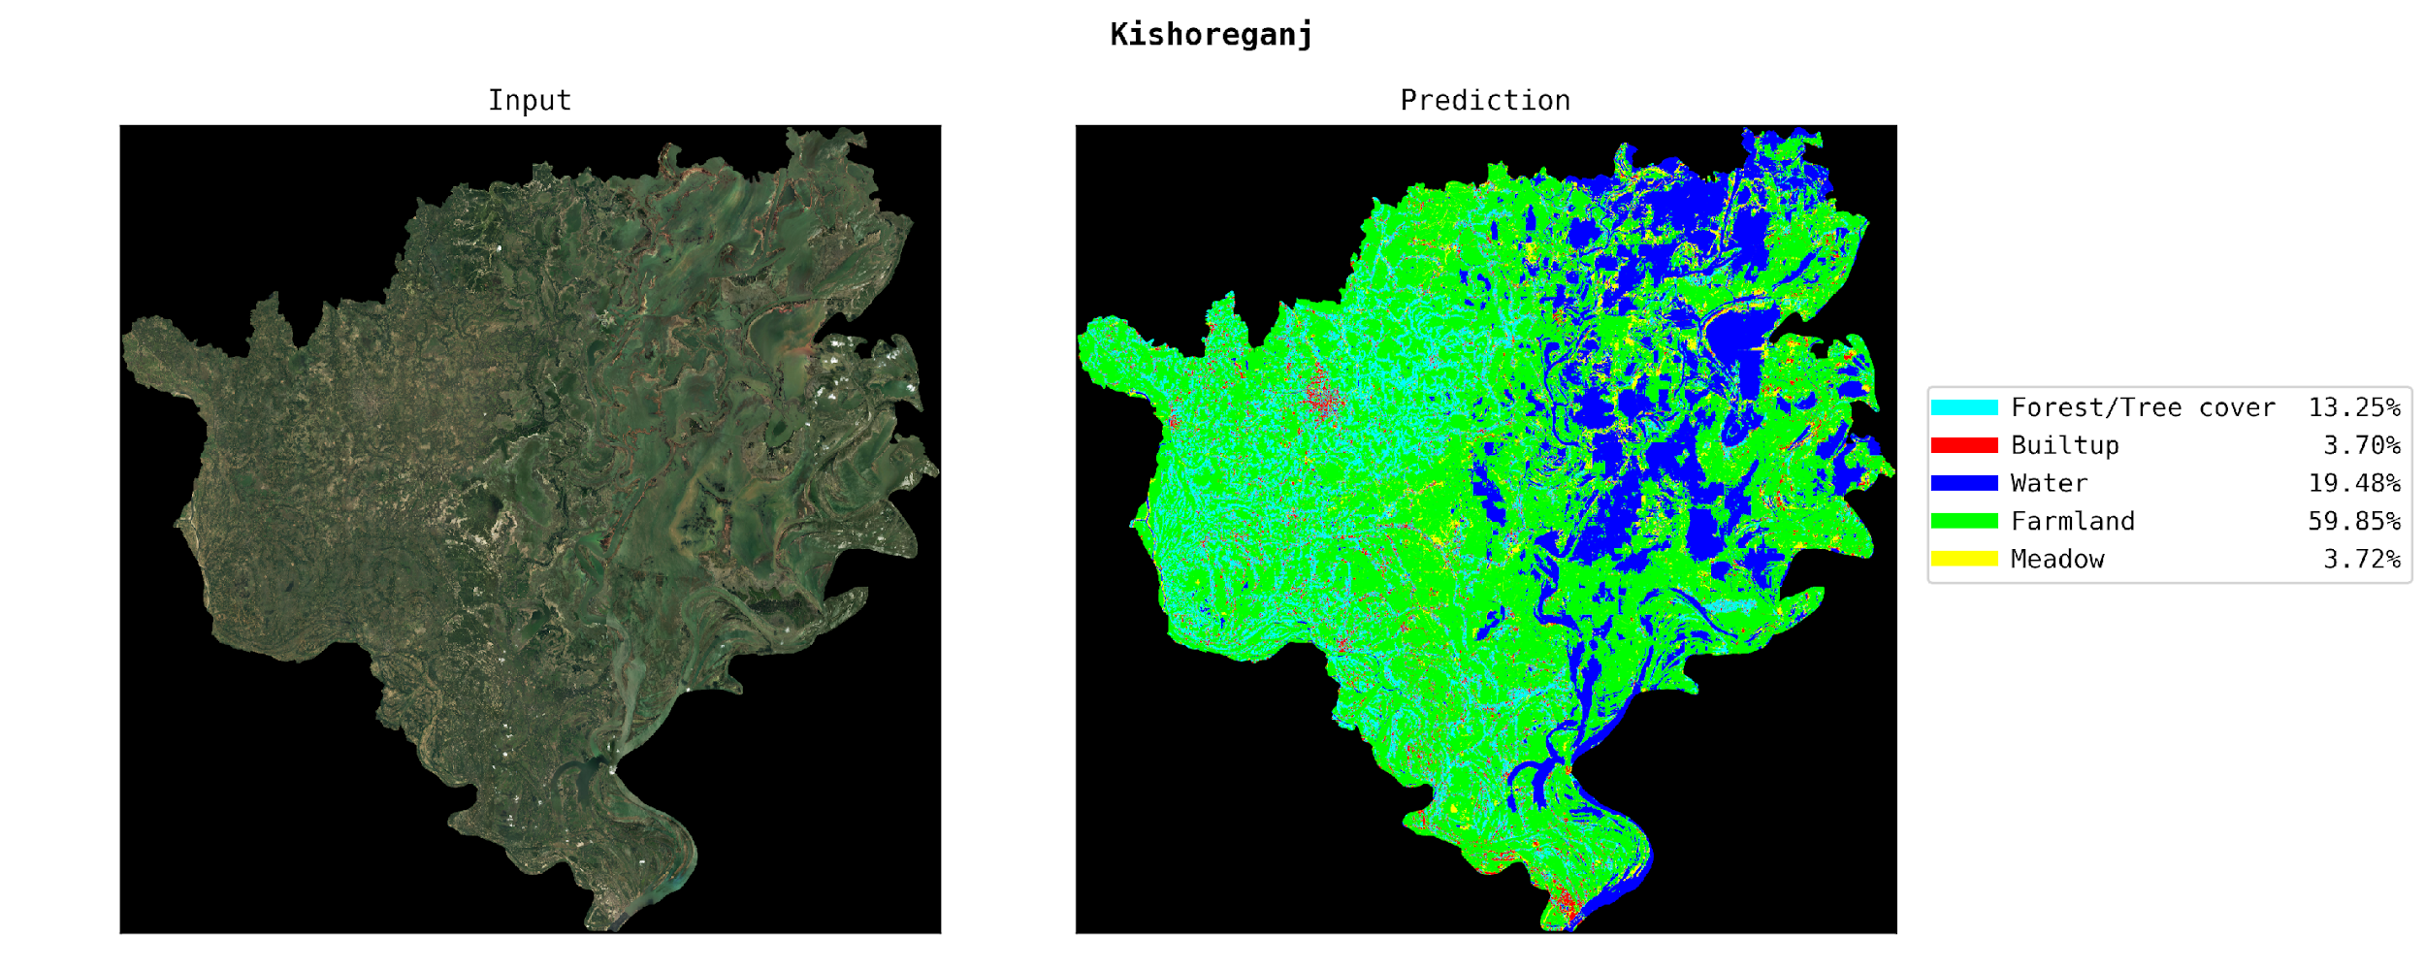

Slide 11
Publications
Abu Bakar Siddik Nayem, Anis Sarker, Ovi Paul, Amin Ali, Md. Ashraful, Amin, A K M M Rahman, "LULC Segmentation of RGB Satellite Image Using FCN-8", 3rd SLAAI-International Conference on Artificial Intelligence, Springer, Srilanka, 2019
F.F. Niloy, M.A. Amin, A.A. Ali, and A K M M Rahman, "Attention toward Neighbors: A Context Aware Framework for High Resolution Image Segmentation", The 28th IEEE International Conference on Image Processing (IEEE - ICIP 2021), Anchorage, USA, (H Index: 52)
Md. Saif Hassan Onim, Aiman Rafeed Ehtesham, Amreen Anbar, A. K. M. Nazrul Islam and A K M M Rahman, "LULC classification by semantic segmentation of satellite images using FastFCN", 2nd International Conference on Advanced Information and Communication Technology (ICAICT), IEEE Xplore, Dhaka, 2020
Under-graduate Thesis
Ovi Paul
ABS Nayem
Anis Sarker

Slide 12
Urban Building categorization
CCDS, Data & Design Lab (DU), CSIS (Univ of Tokyo)

Slide 13
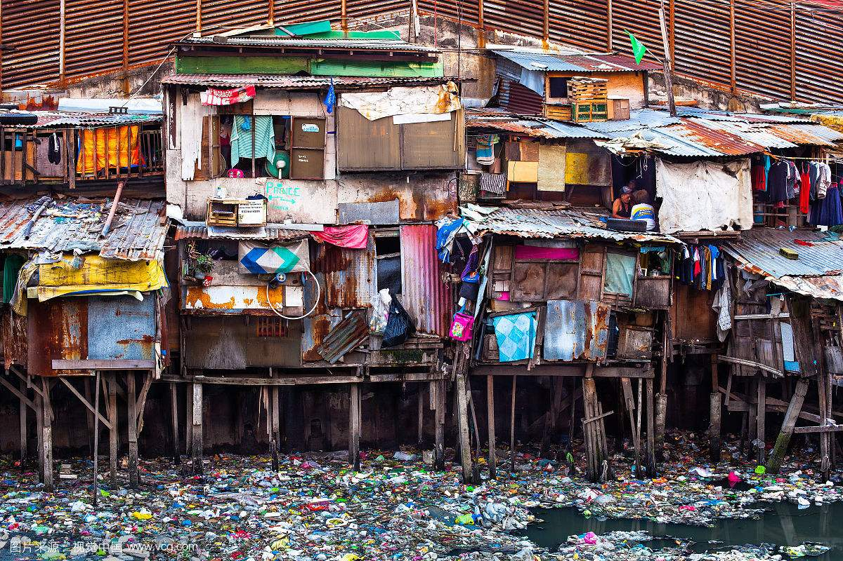
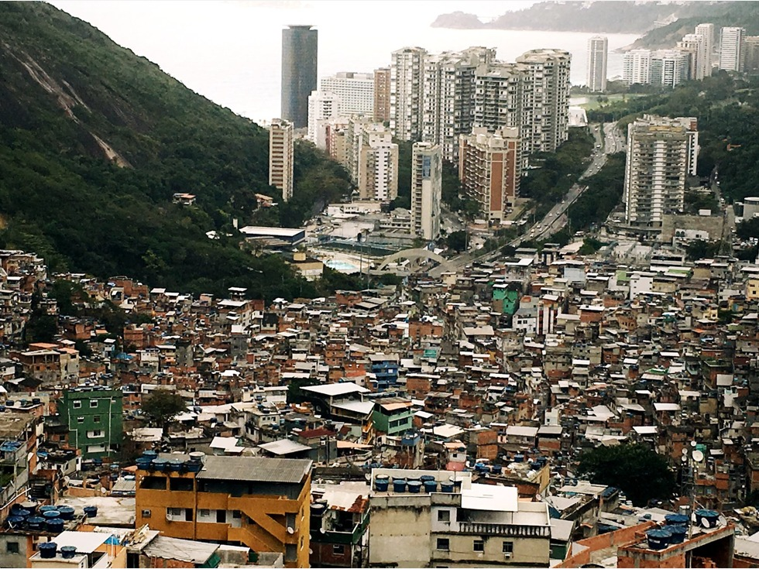
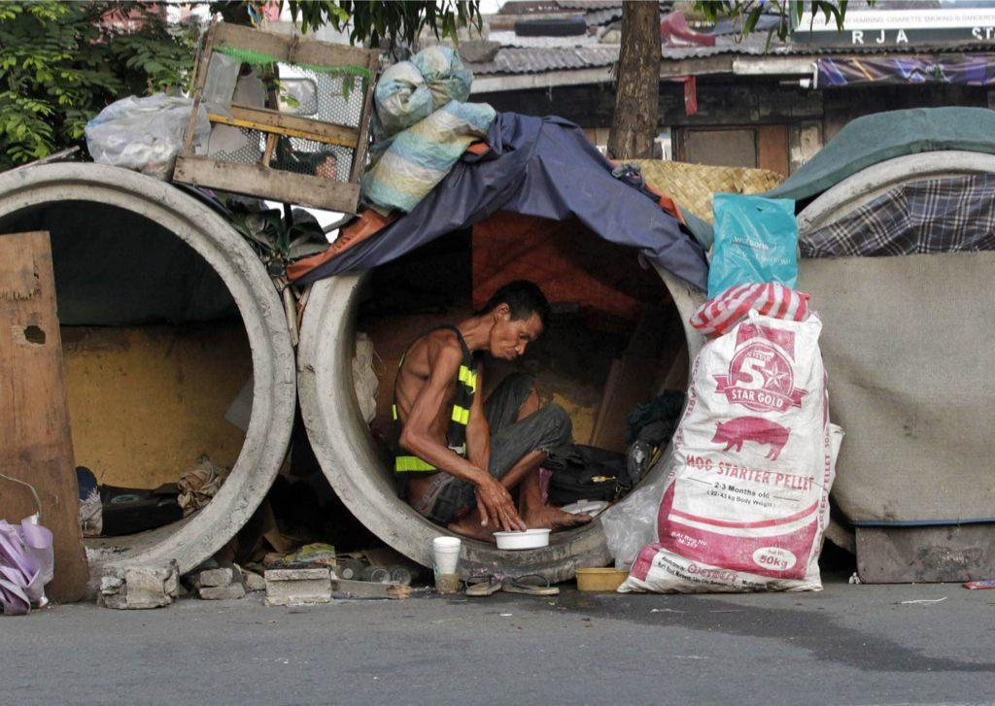
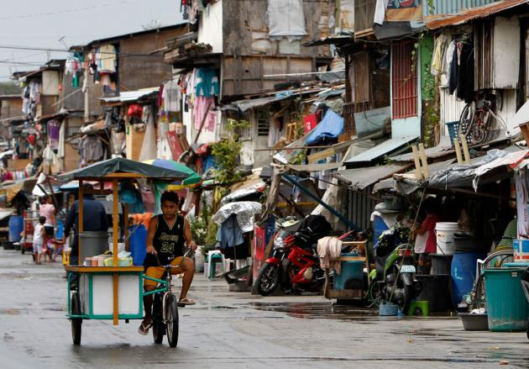
What and why do we want to understand Urban environment and residence in developing country

Slide 14
Motivation
Recent studies on urban categorization are based on simple structural criteria, such as
the types and conditions of individual buildings
building density, building
height, and building scale
However, the spatial structure and pattern of the urban environment are diverse and complex due to various factors, such as
building materials, surrounding environment, shabby structures,
roofs made of cheap material, limited road access, high density, and varying building heights.
Unlike developed countries, these cities do not have dedicated residential areas, industrial areas, and pre-planned marketplaces
Notes:
too small to read

Slide 15
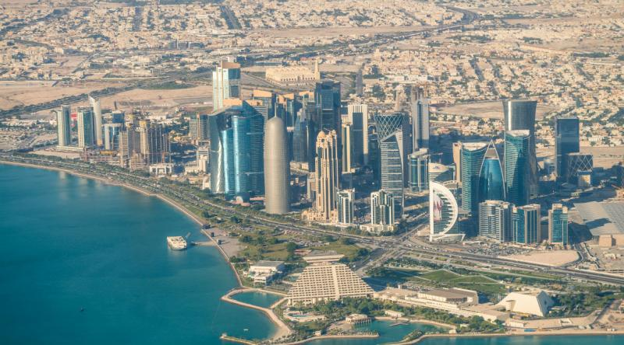
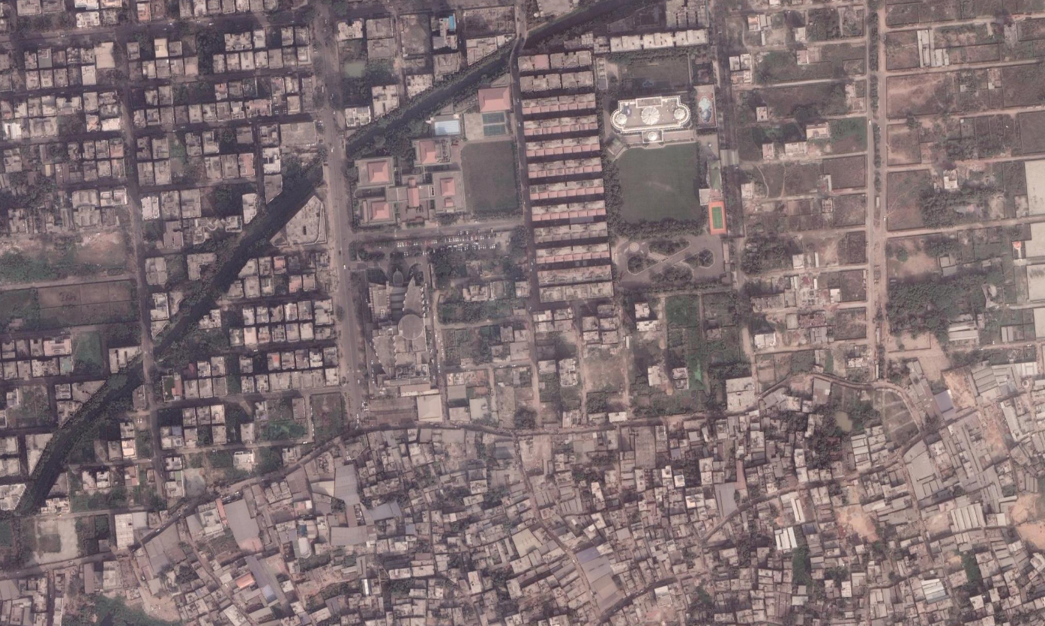
Example

Slide 16
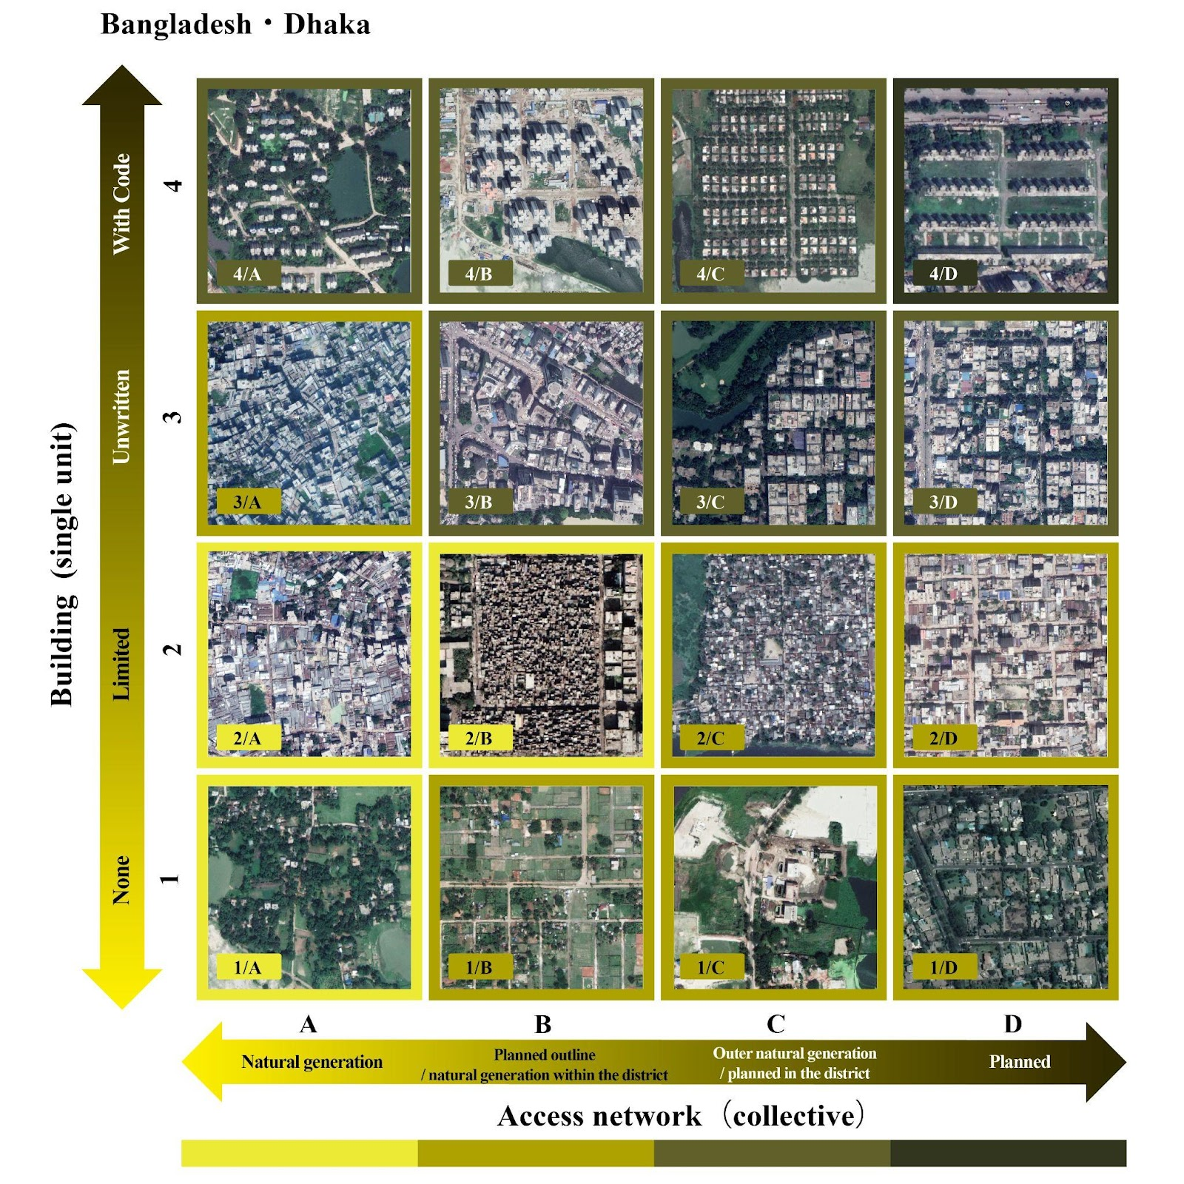
Two axis view

Slide 17
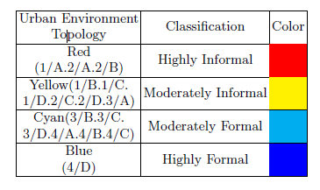
Socio-economic area

Slide 18
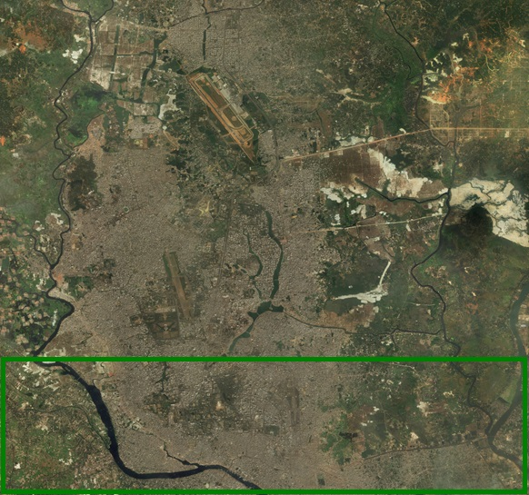
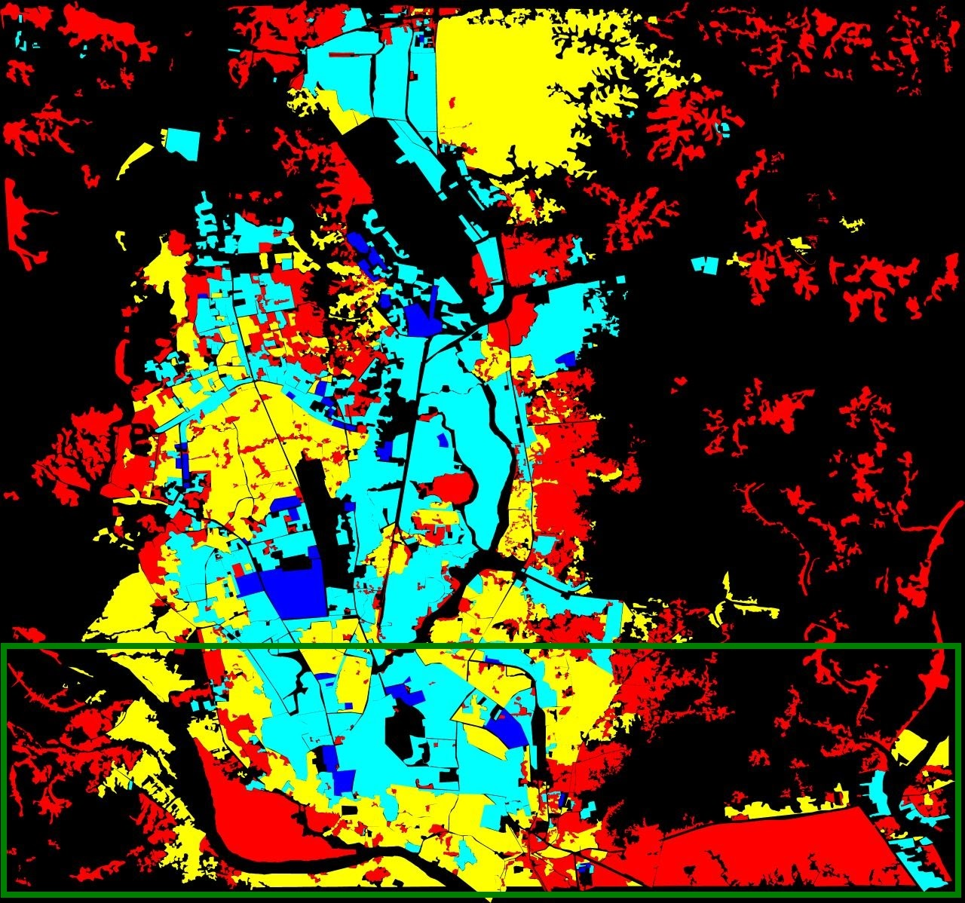
Ground Truth for Dhaka
Red: Highly informal area (Arrival city)
Yellow: Moderately Informal area
Green: Moderately Formal area
Blue: Highly Formal area

Slide 19
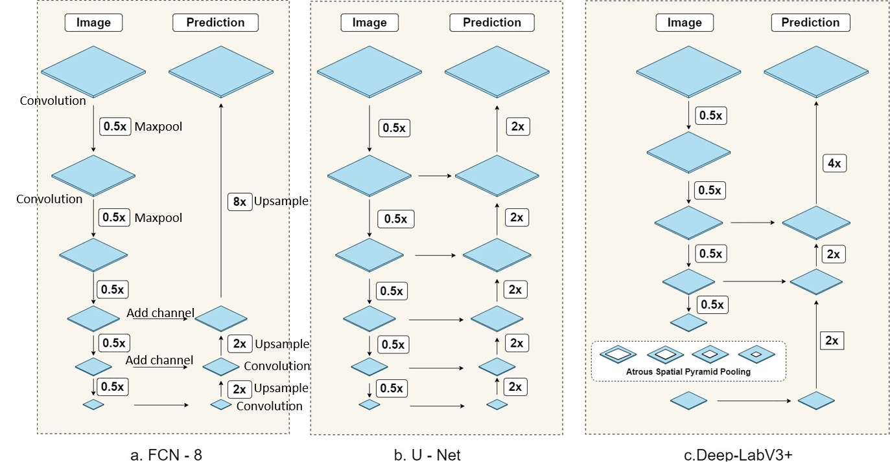
Segmentation Models

Slide 20
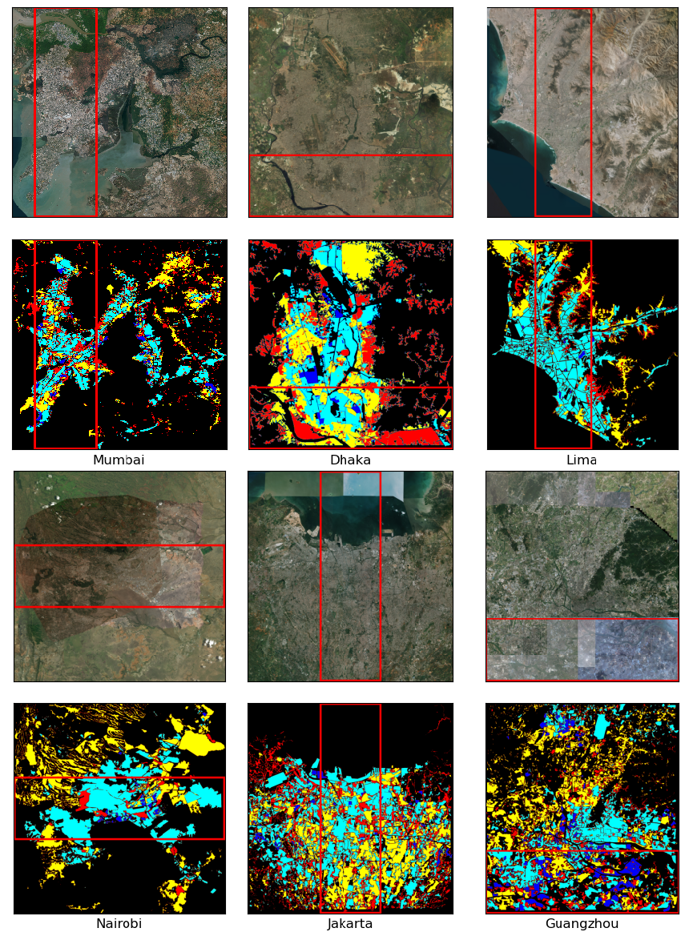
Building Categorization on seven cities

Slide 21
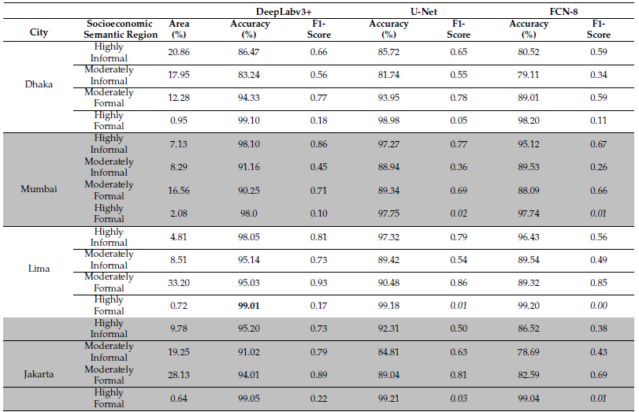
Detail performance across six cities
Notes:
why are the models bad for highly formal

Slide 22
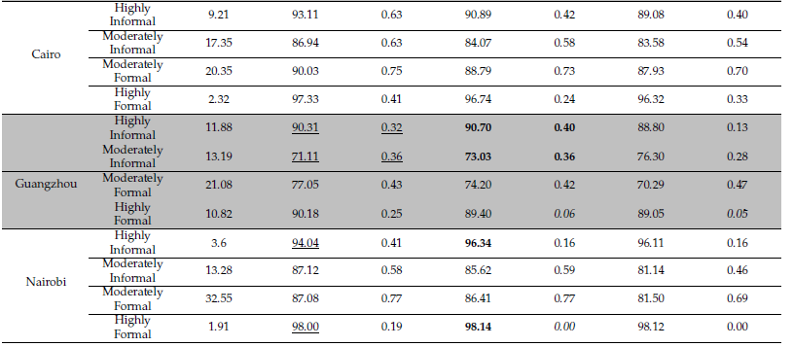
Detail performance across six cities
Notes:
why are the models bad for highly formal

Slide 23
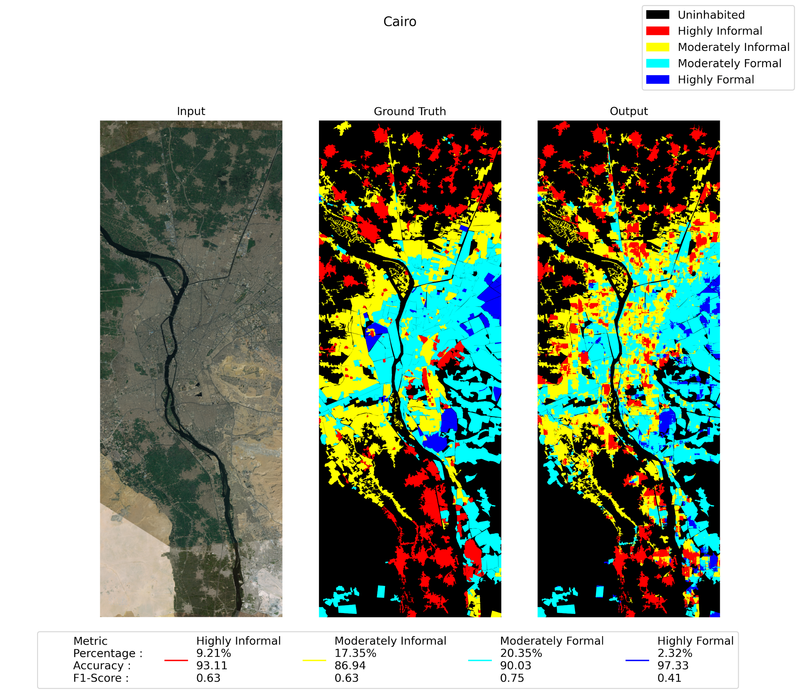
Building Categorization on Cairo Test data

Slide 24
Publications
Qianwei Cheng*, Moinul Zaber*, A K M M Rahman*, Haoran Zhang, Zhiling Guo, Akiko Okabe, Ryosuke Shibasaki, "Understanding the urban environment of developing countries from satellite images", MDPI Sustainability, (Impact factor: 3.251, Scimago Journal Rank: Q1), 2022; *Equal Contribution
A K M M Rahman, Moinul Zaber, Qianwei Cheng, Abu Bakar Siddik Nayem, Anis Sarker, Ovi Paul, and Ryosuke Shibasaki, "Applying State-of-the-Art Deep-Learning Methods to Classify Urban Cities of the Developing World", Special Issue: Urban Information Sensing for Sustainable Development, MDPI Sensors (Impact factor: 3.57, Scimago Journal Rank: Q1 ), 2021

Slide 25
Automatic Detection of Natural Disaster Effect on Paddy Field from Satellite Images using Deep Learning Techniques
CCDS

Slide 26
Motivation
Manual loss estimation due to natural disaster is time consuming
Develop ground truth for damaged paddy field
Use free sentinal-2 satellite images
Use Deep learning model to predict paddy loss

Slide 27
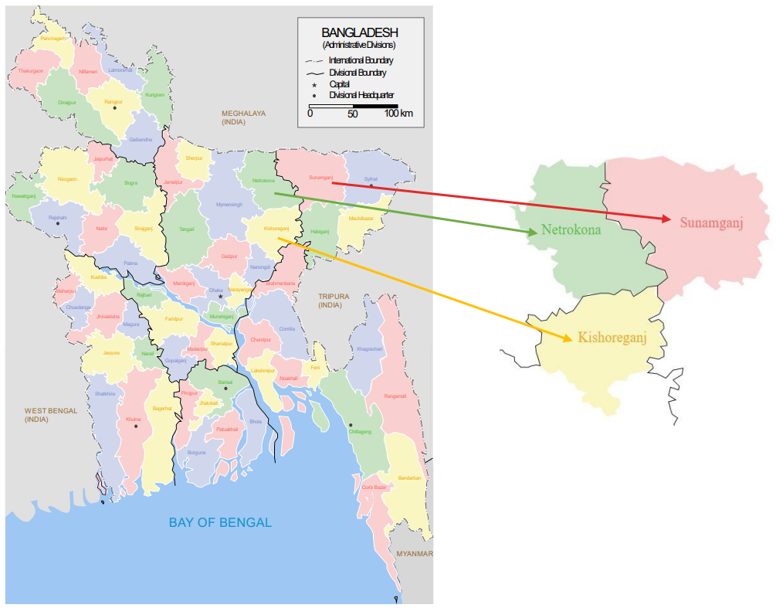
Study Area in Bangladesh

Slide 28
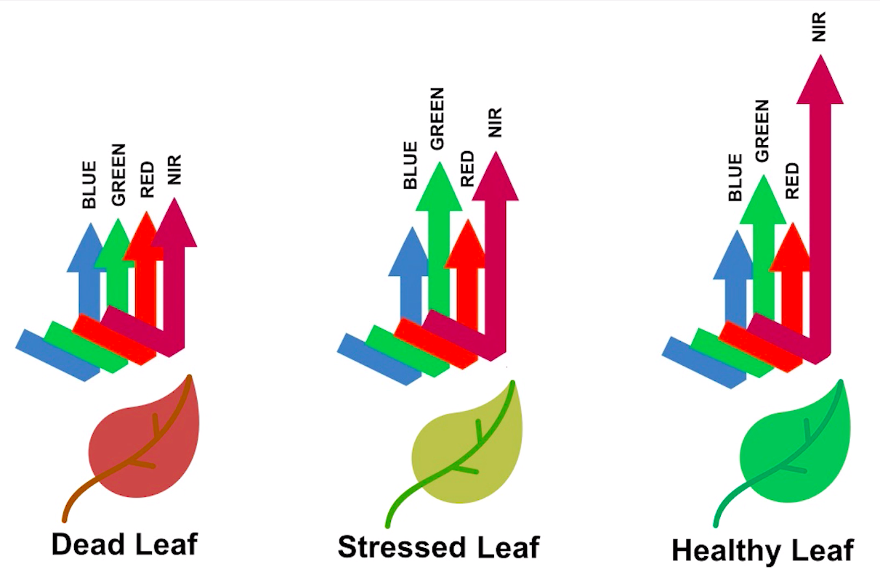
Natural Disaster in Study Area
Heavy Hail Storms (April 2019)
No natural disaster (2020)
Heat Wave (April 2021)

Slide 29
Contributions
Use normalized difference vegetation index (NDVI) to mark the paddy loss due to natural disasters
Use deep learning based semantic segmentation on visual image RGB channel and False Color Infrared (FCI) image
Compare performances between RGB and FCI

Slide 30
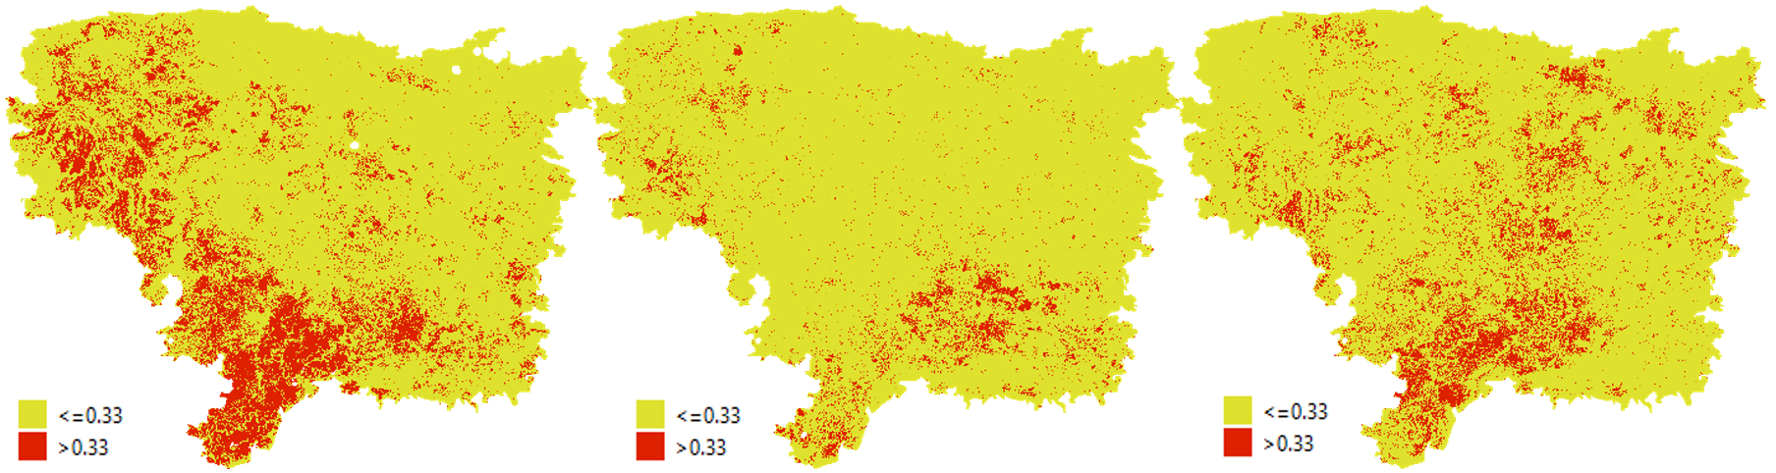
Sunamganj NDVI Different images
2019
2020
2021

Slide 31
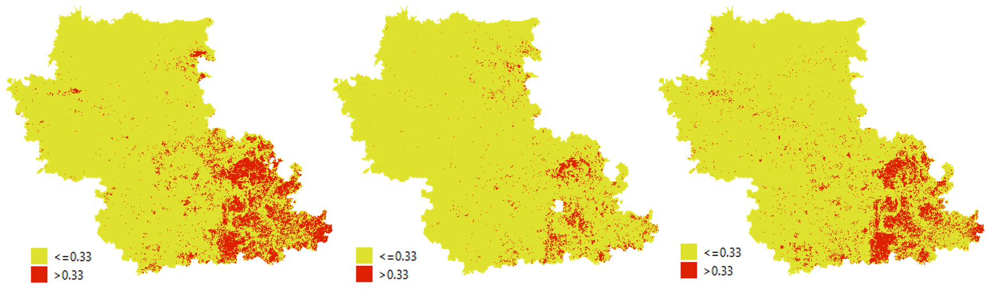
Netrokona NDVI Different images
2019
2020
2021

Slide 32
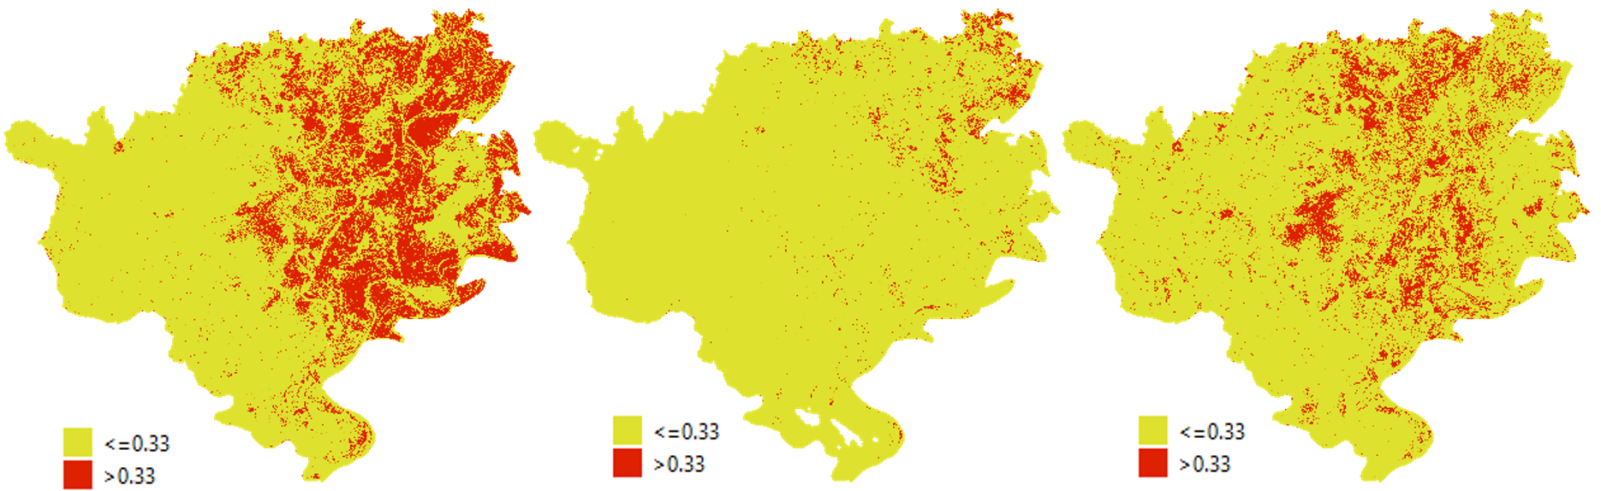
Kisorganj NDVI Different images
2019
2020
2021

Slide 33
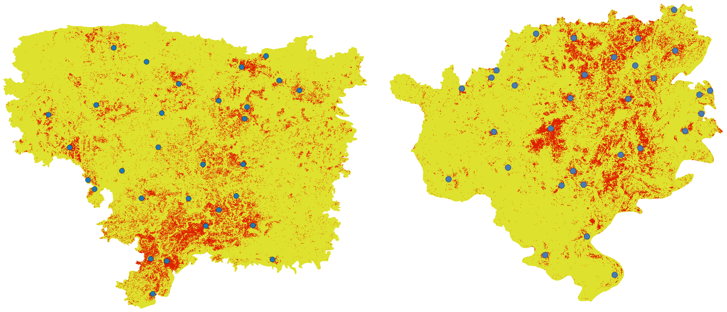
Verify NDVI difference as Ground Truth
Sunamganj places
Kisorganj places

Slide 34
Overall evaluation for RGB & FCI test image
Different Images | Metric | Crop loss area | Rest of the areas | Mean
RGB | IoU | 0.4085524975 | 0.9045643798 | 0.7707688571
 | F1 | 0.5801026206 | 0.9498911031 | 0.8431961355
FCI | IoU | 0.515450204 | 0.9162863996 | 0.8103889453
 | F1 | 0.6802601665 | 0.9563146717 | 0.8787632911

Slide 35
Publication
Tahmid Alavi Ishmam, Amin Ahsan Ali, M Ashraful Amin, and A K M M Rahman, "Automatic Detection of Natural Disaster Effect on Paddy Field from Satellite Images using Deep Learning Techniques", 8th International Conference on Control and Robotics Engineering (ICCRE 2023), Niigata, Japan
Undergraduate Thesis
(Tahmid Alavi Ishmam)

Slide 36
Land Use Land Cover Segmentation using Synthetic Aperture Radar Data on Dhaka Division, Bangladesh
CCDS

Slide 37
PROBLEM STATEMENT
Bangladesh's vulnerability to unpredictable weather patterns, frequent floods, and other natural calamities necessitates monitoring and prediction of crop yields to mitigate the risk of crop destruction
Limitations of Traditional Mapping Approaches
Cloud Cover Challenge in Optical Remote Sensing
Rainy seasons in Bangladesh often coincide with key rice growth stages and period (April-June)
Difficulties in high-resolution paddy rice mapping due to cloud cover

Slide 38
Motivation
Leveraging Sentinel-1A Synthetic Aperture Radar (SAR) data
Valuable information during cloud-covered months and atmospheric disturbances.

Slide 39

Sentinel 1-A Data Acquisition
Data Pre-Processing
Dataset
Model
Evaluation Metrics

Slide 40
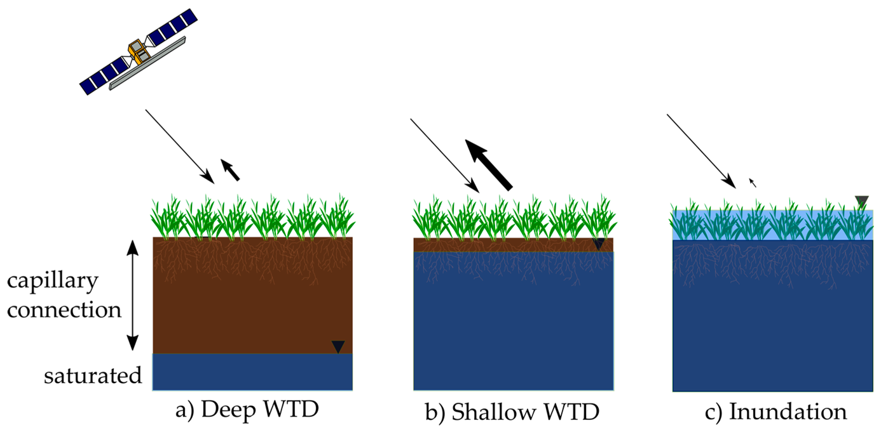
SENTINEL-1A DATA
Sentinel-1A emits C-band radar signals that interact with Earth's terrain and objects.
These objects reflect some signals back, carrying surface characteristics.
The satellite processes these reflected signals (backscatter) into radar images.
Features:
C-band radar
4-8GHz
longer wavelengths (~3.5 cm)
Dual Polarization (VV/VH)
VV - surface roughness and vegetation
VH - surface scattering and structural changes

Slide 41
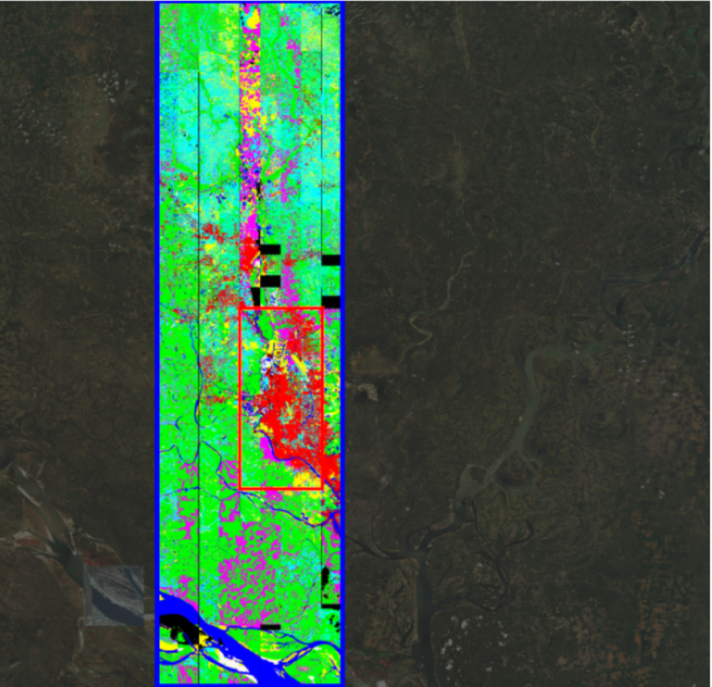
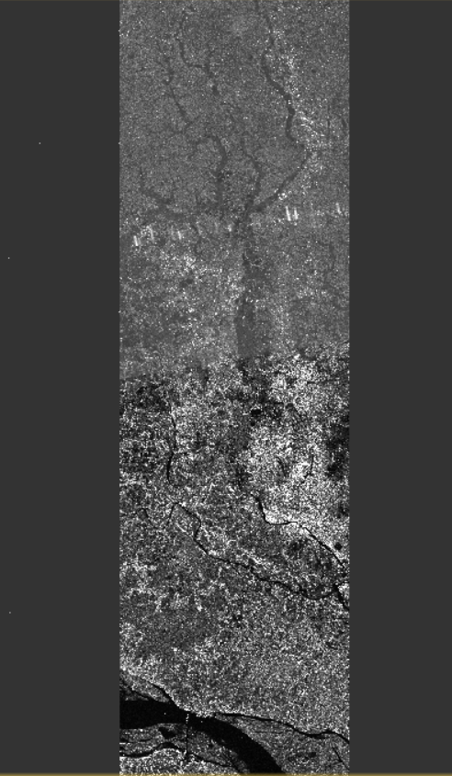
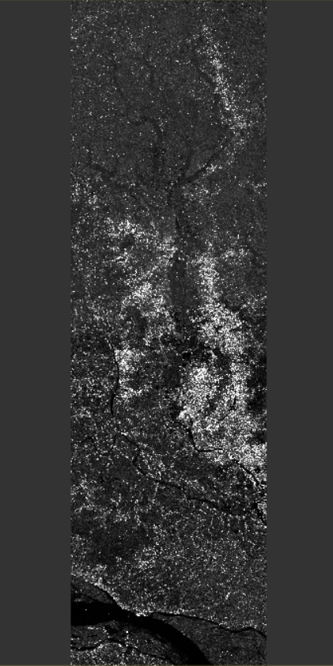
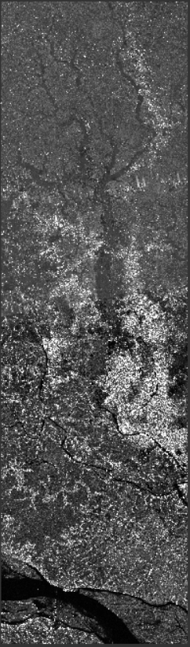
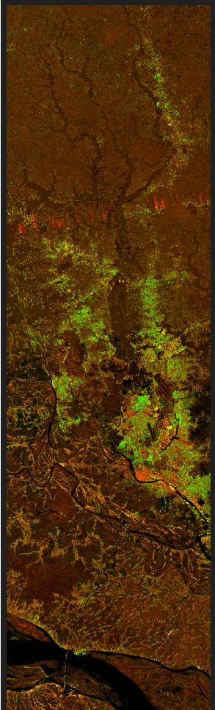
Mask
VV
VH
VV/VH
Stacked SAR image in PNG format

Slide 42


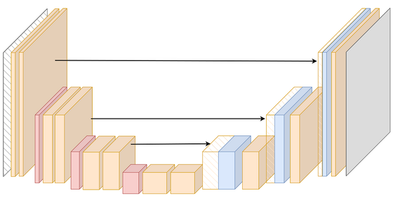
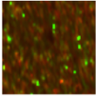

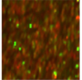
EXPERIMENT
‘accuracy’ and ‘loss’ printed to monitor progress
OUTPUT
GT train label patches
One-hot encoded labels added
(0-4)
Model for training
Model
Weights Saved
S-1A train data patches
Model Evaluation using Test data
Conducted a 5-fold cross-validation strategy.
Metrics averaged over the 5 rounds for robust performance estimation.
S-1A and GT test patches
(20%)
RESULT

Slide 43
RESULT & DISCUSSION
 | SenRGB | SenRGB
Metric | IoU | F1
Farmland | 0.46 | 0.63
Water | 0.30 | 0.46
Forest | 0.18 | 0.30
Urban Built Up | 0.54 | 0.70
Meadow | 0.25 | 0.40
Avg | 0.34 | 0.49
 | Sentinel-1A | Sentinel-1A
Metric | IoU | F1
Farmland | 0.56 | 0.72
Water | 0.29 | 0.39
Forest | 0.05 | 0.12
Urban Built Up | 0.21 | 0.33
Meadow | 0.26 | 0.44
Avg | 0.27 | 0.40
 | Sentinel-1A | Sentinel-1A
Metric | IoU | F1
Farmland | 0.53 | 0.69
Water | 0.19 | 0.30
Forest | 0.12 | 0.17
Urban Built Up | 0.20 | 0.32
Meadow | 0.30 | 0.45
Avg | 0.27 | 0.49
Reference Data.
Average IoU and F1 scores for S-1A data
UNET
Average IoU and F1 scores for S-1A data
DeepLabV3+
Accuracy: 82%
Accuracy: 76%
Accuracy: 84%

Slide 44
RESULT & DISCUSSION
Strong Areas: Higher IoU and F1 scores in "Farmland," "Water" and "Meadow" compared to reference.
Weak Areas: Lower performance in "Urban Built Up" and "Forest" compared to reference.
DeepLabV3+ performed better in identifying Forest than UNET, but dipped performance in classifying Water.

Slide 45
Publication
Undergraduate Thesis
(Sadia Khan, Mir Sayad Bin Almas)
Manuscript under preparation for conference/journal publication

Slide 46
Realtime monitoring of Poverty and Poverty induced migration through Automatic Slum Detection using Deep Learning Model in Dhaka city
CDDS, DnD Lab

Slide 47
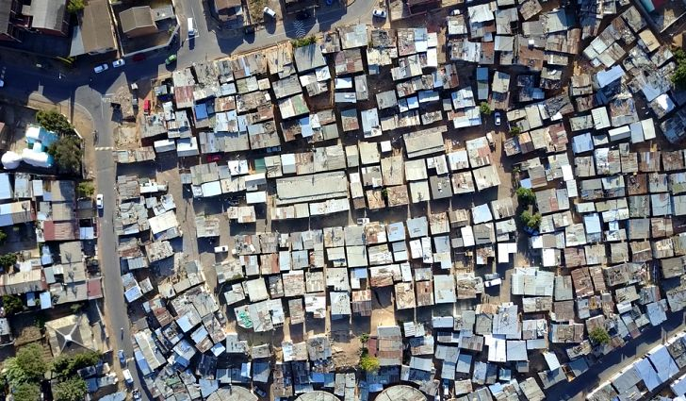
Properties of Slum [1]
Shanty Structures (Jhupri, tin-shed)
High Density
Unhygienic Water supply and sanitation
In adequate road facilities
Very low Socio-economic condition
[1] Bangladesh Slum Census and Floating population Report, 2014

Slide 48
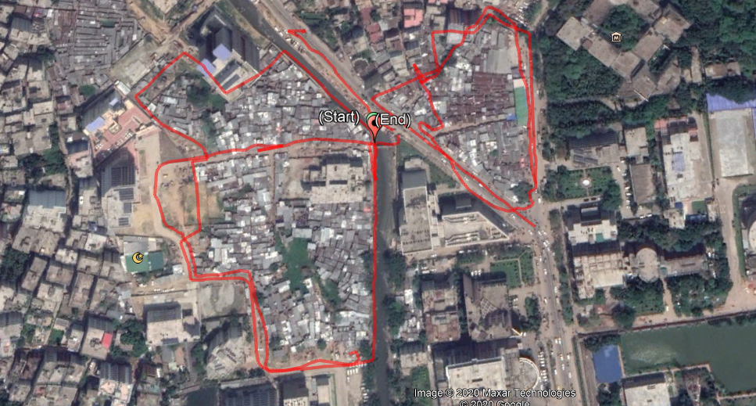
Slum vs Non-slum

Slide 49
Ground Truth Collection
Ground truth collection by physically visiting slums
Using Gaia map and Gaia photo
Slum Boundary annotation
Overlaying the slum on Satellite Image
Deep Learning Model

Slide 50
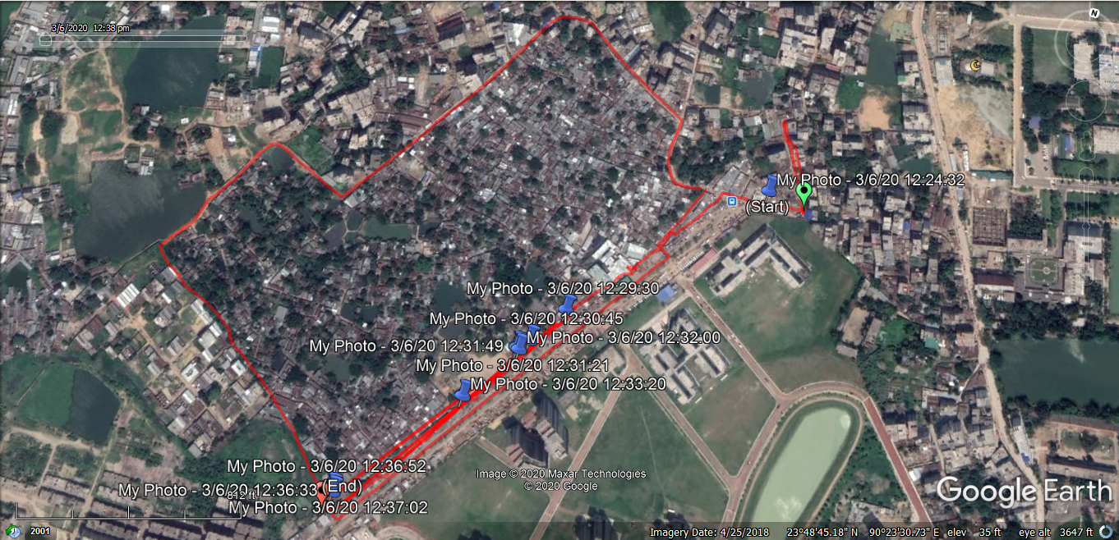
Slums Contour mapping using GPS device

Slide 51
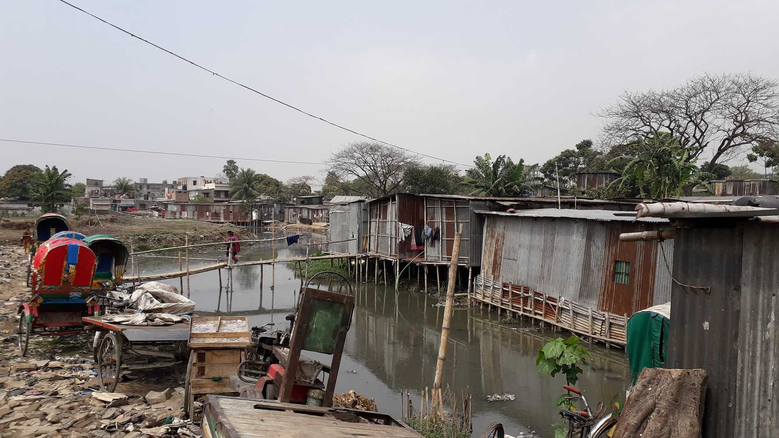
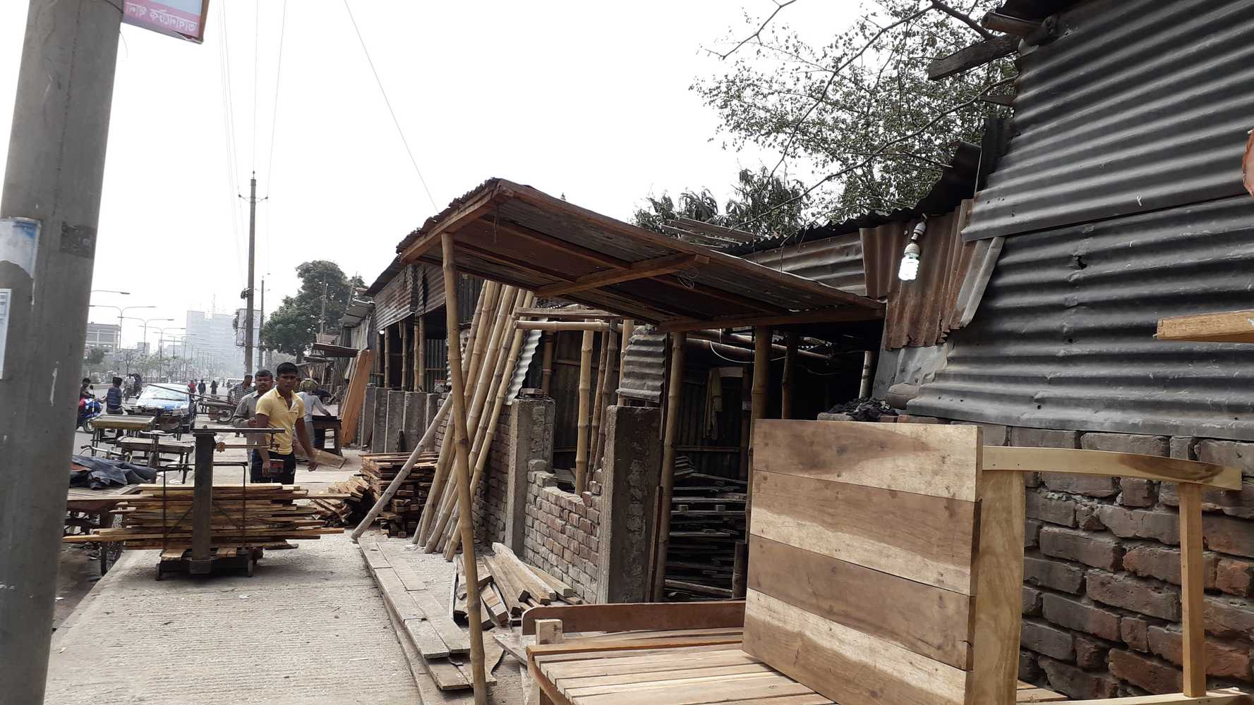
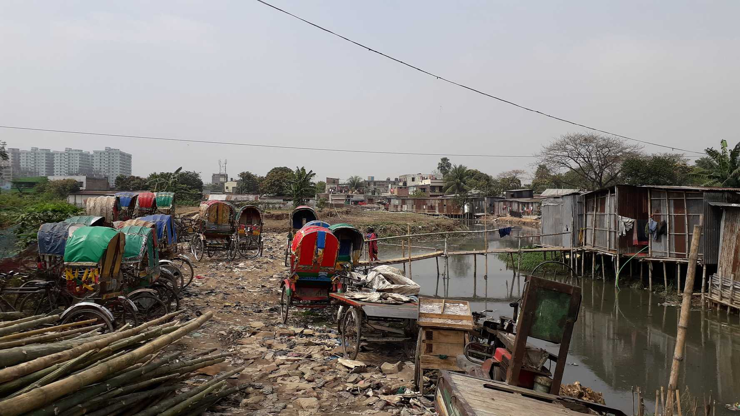
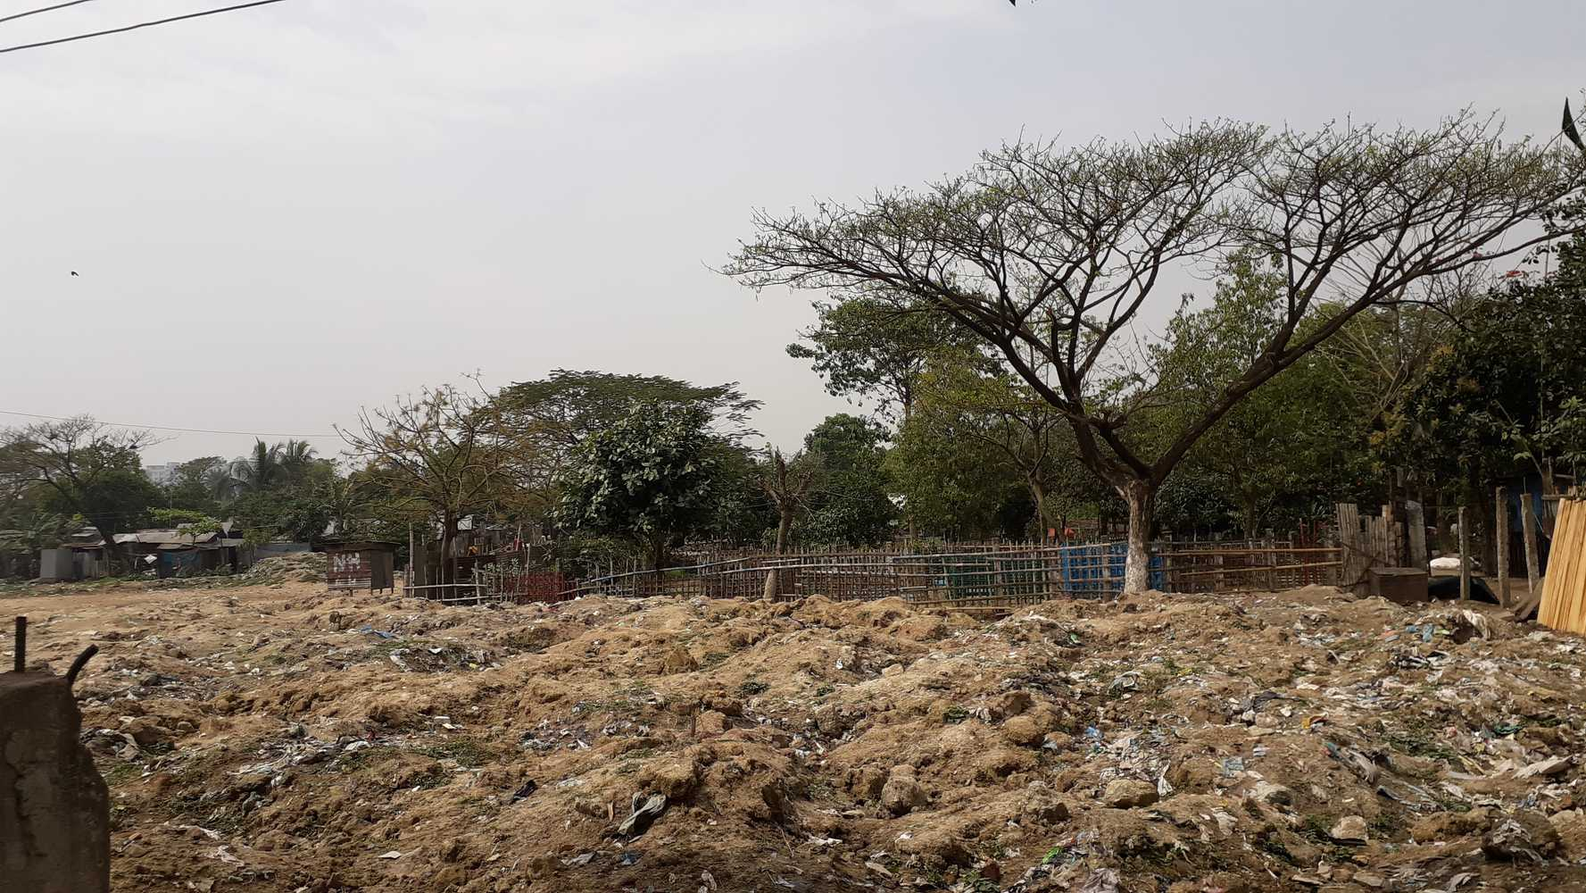
Photos

Slide 52
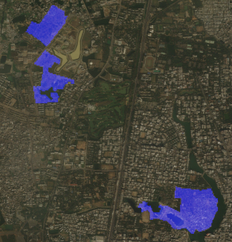
Overlay the slum on Satellite Image

Slide 53
DPDC power consumption vs NTL DPDC power consumption vs Building Cat DPDC power consumption vs LULC
CCDS, DnD Lab

Slide 54
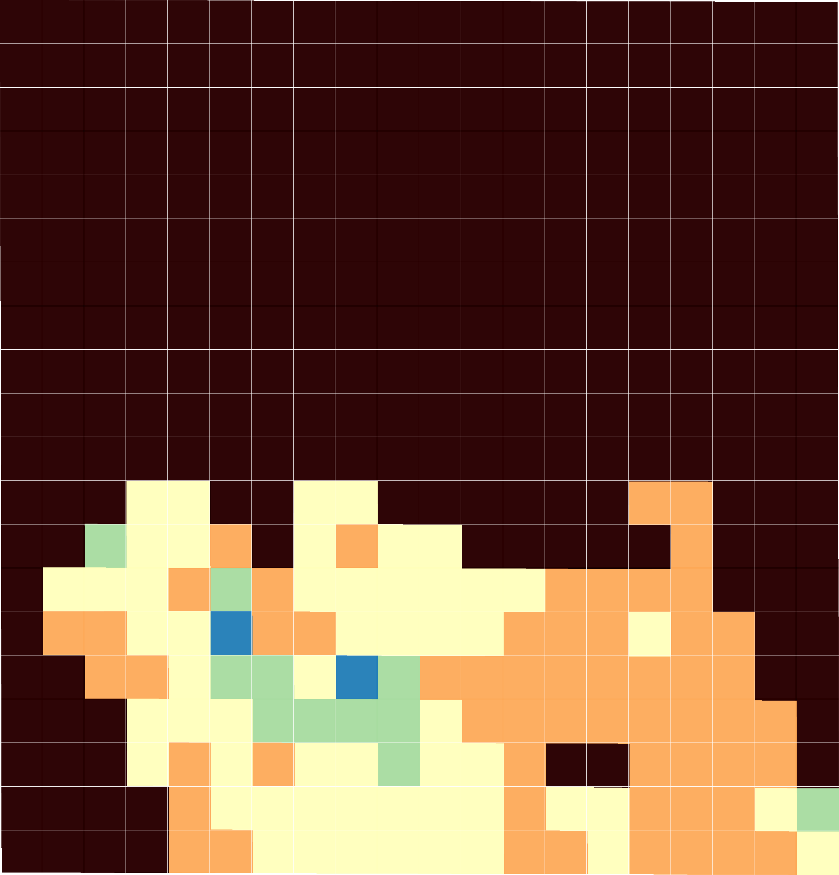
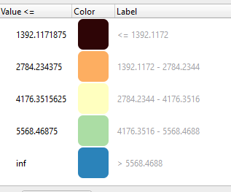
DPDC Data (1 km x 1 km block) Average Power Consumption

Slide 55
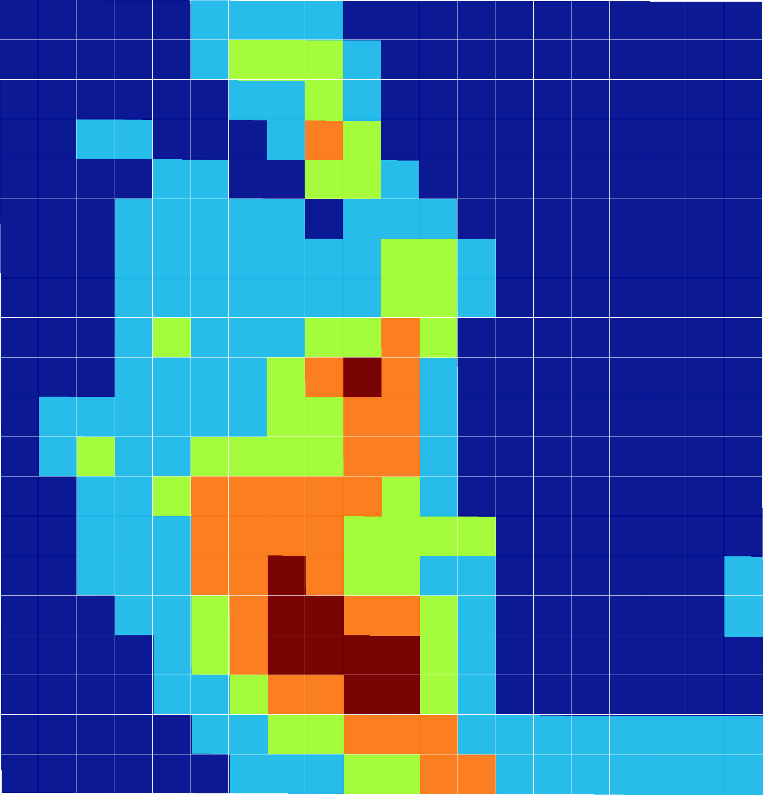
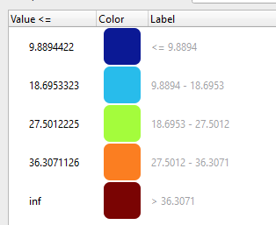
Night Light (1 km x 1 km block) Average light

Slide 56
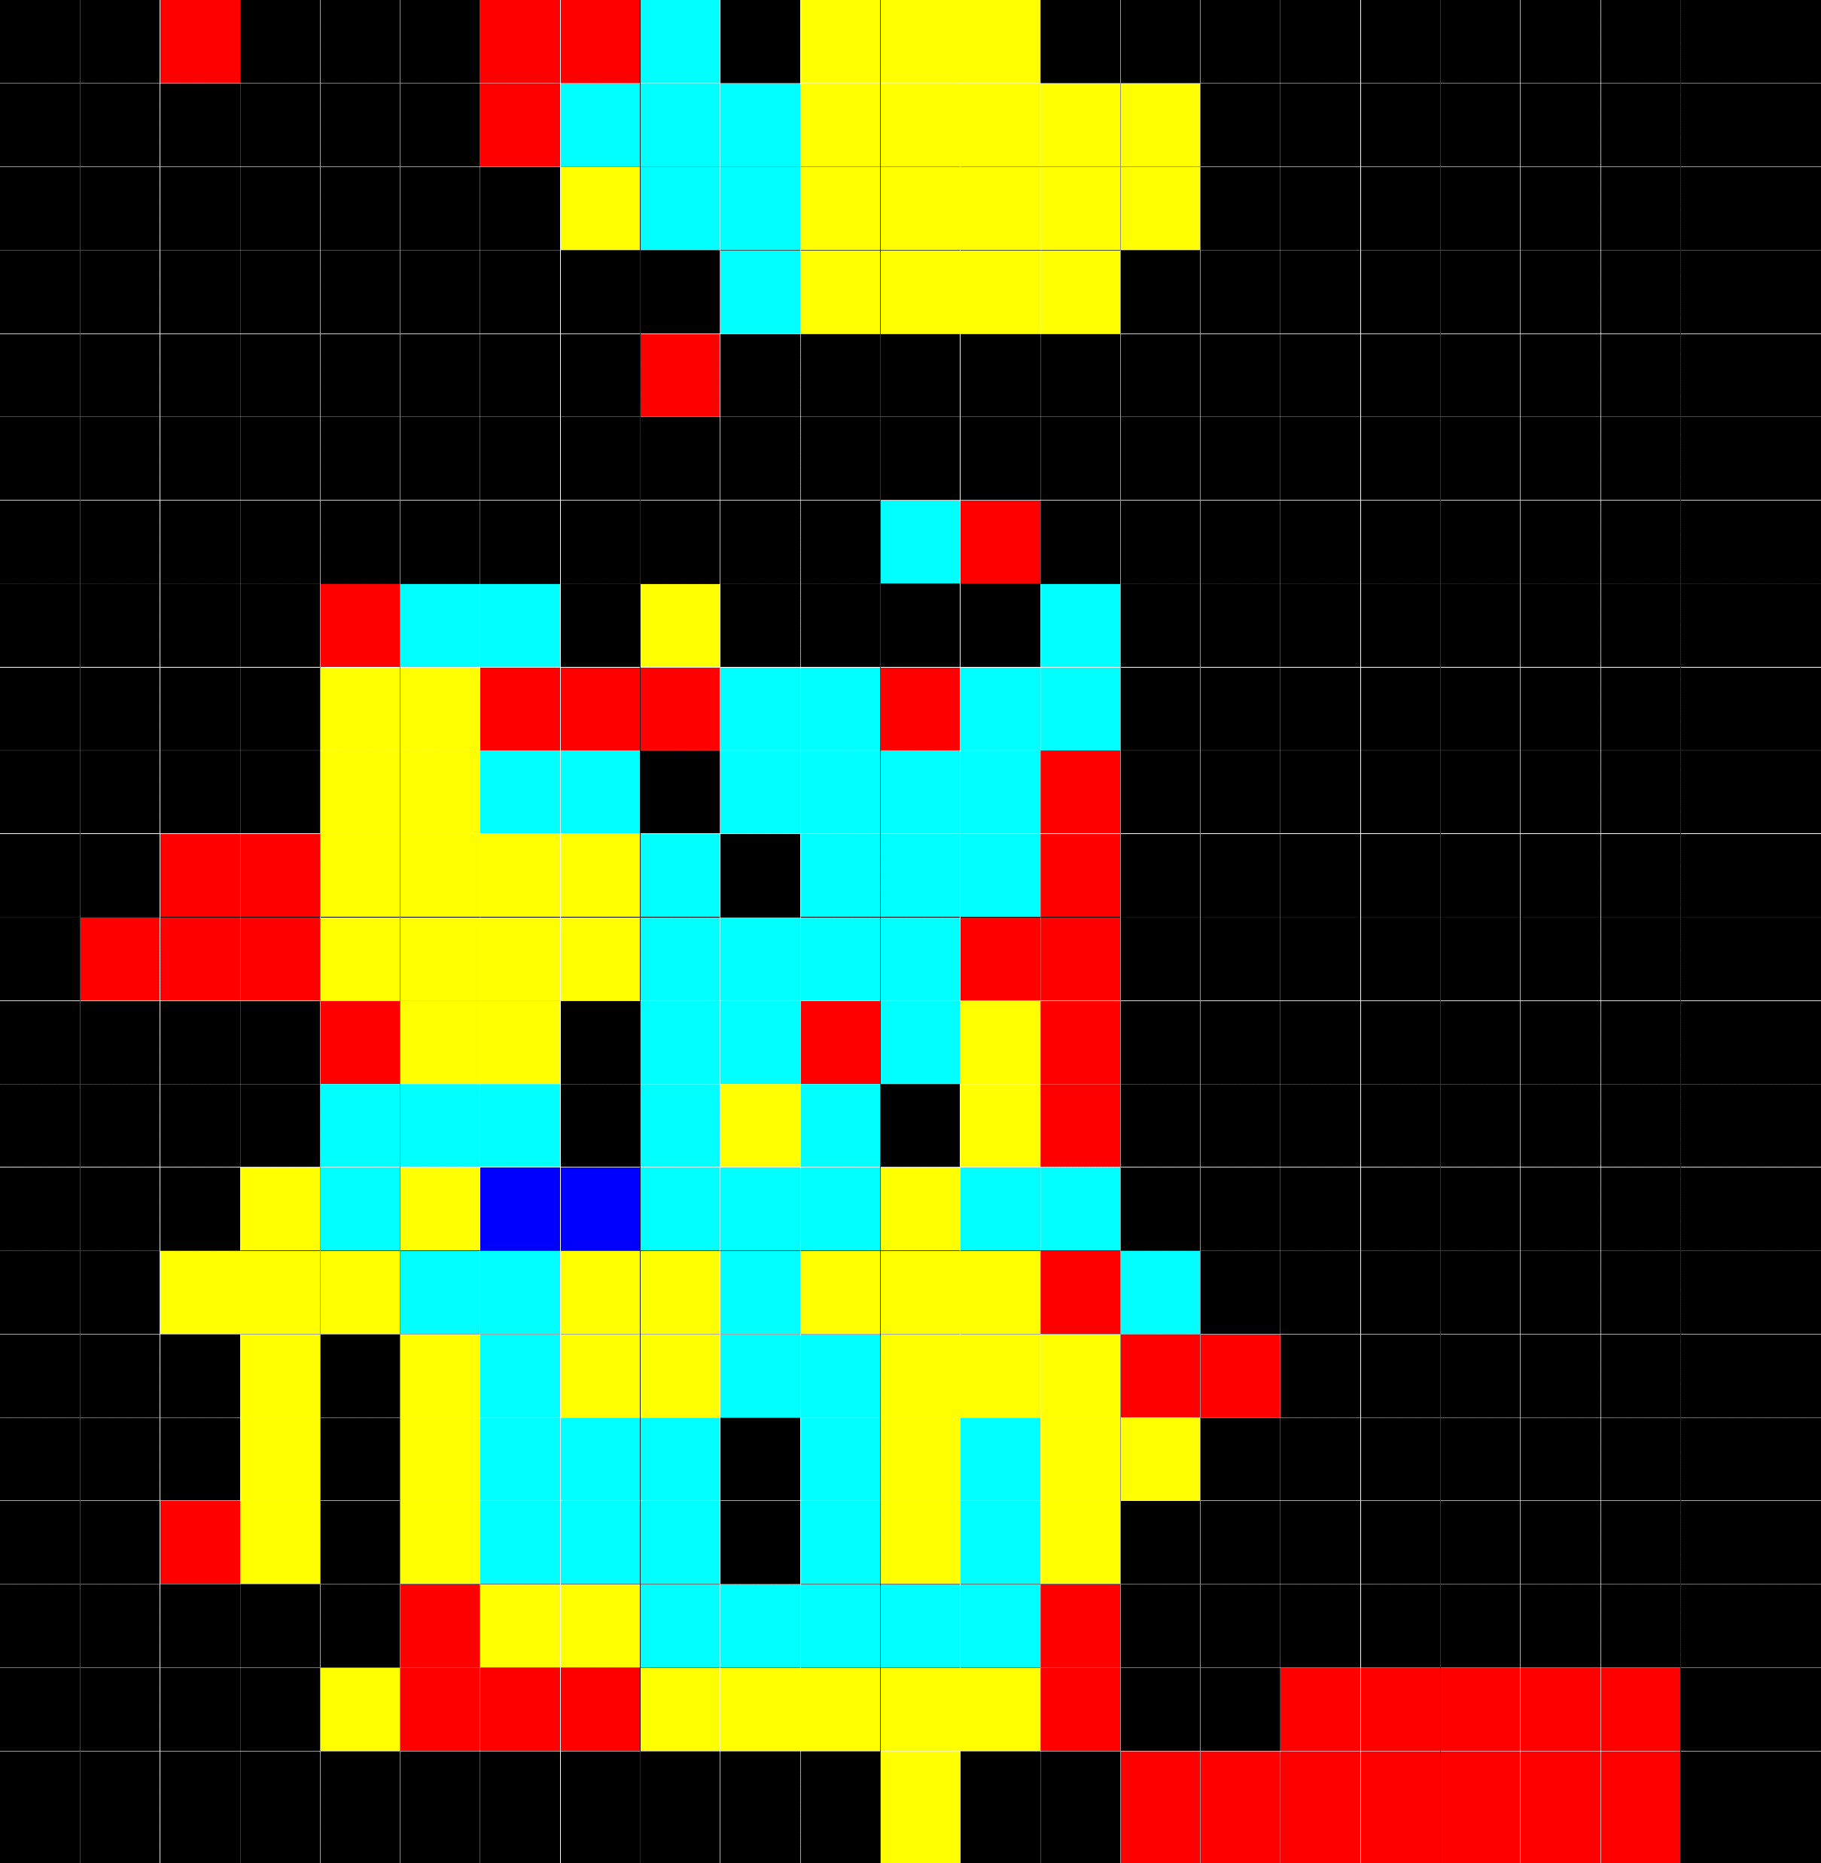

Building Categorization (1 km x 1 km block)

Slide 57
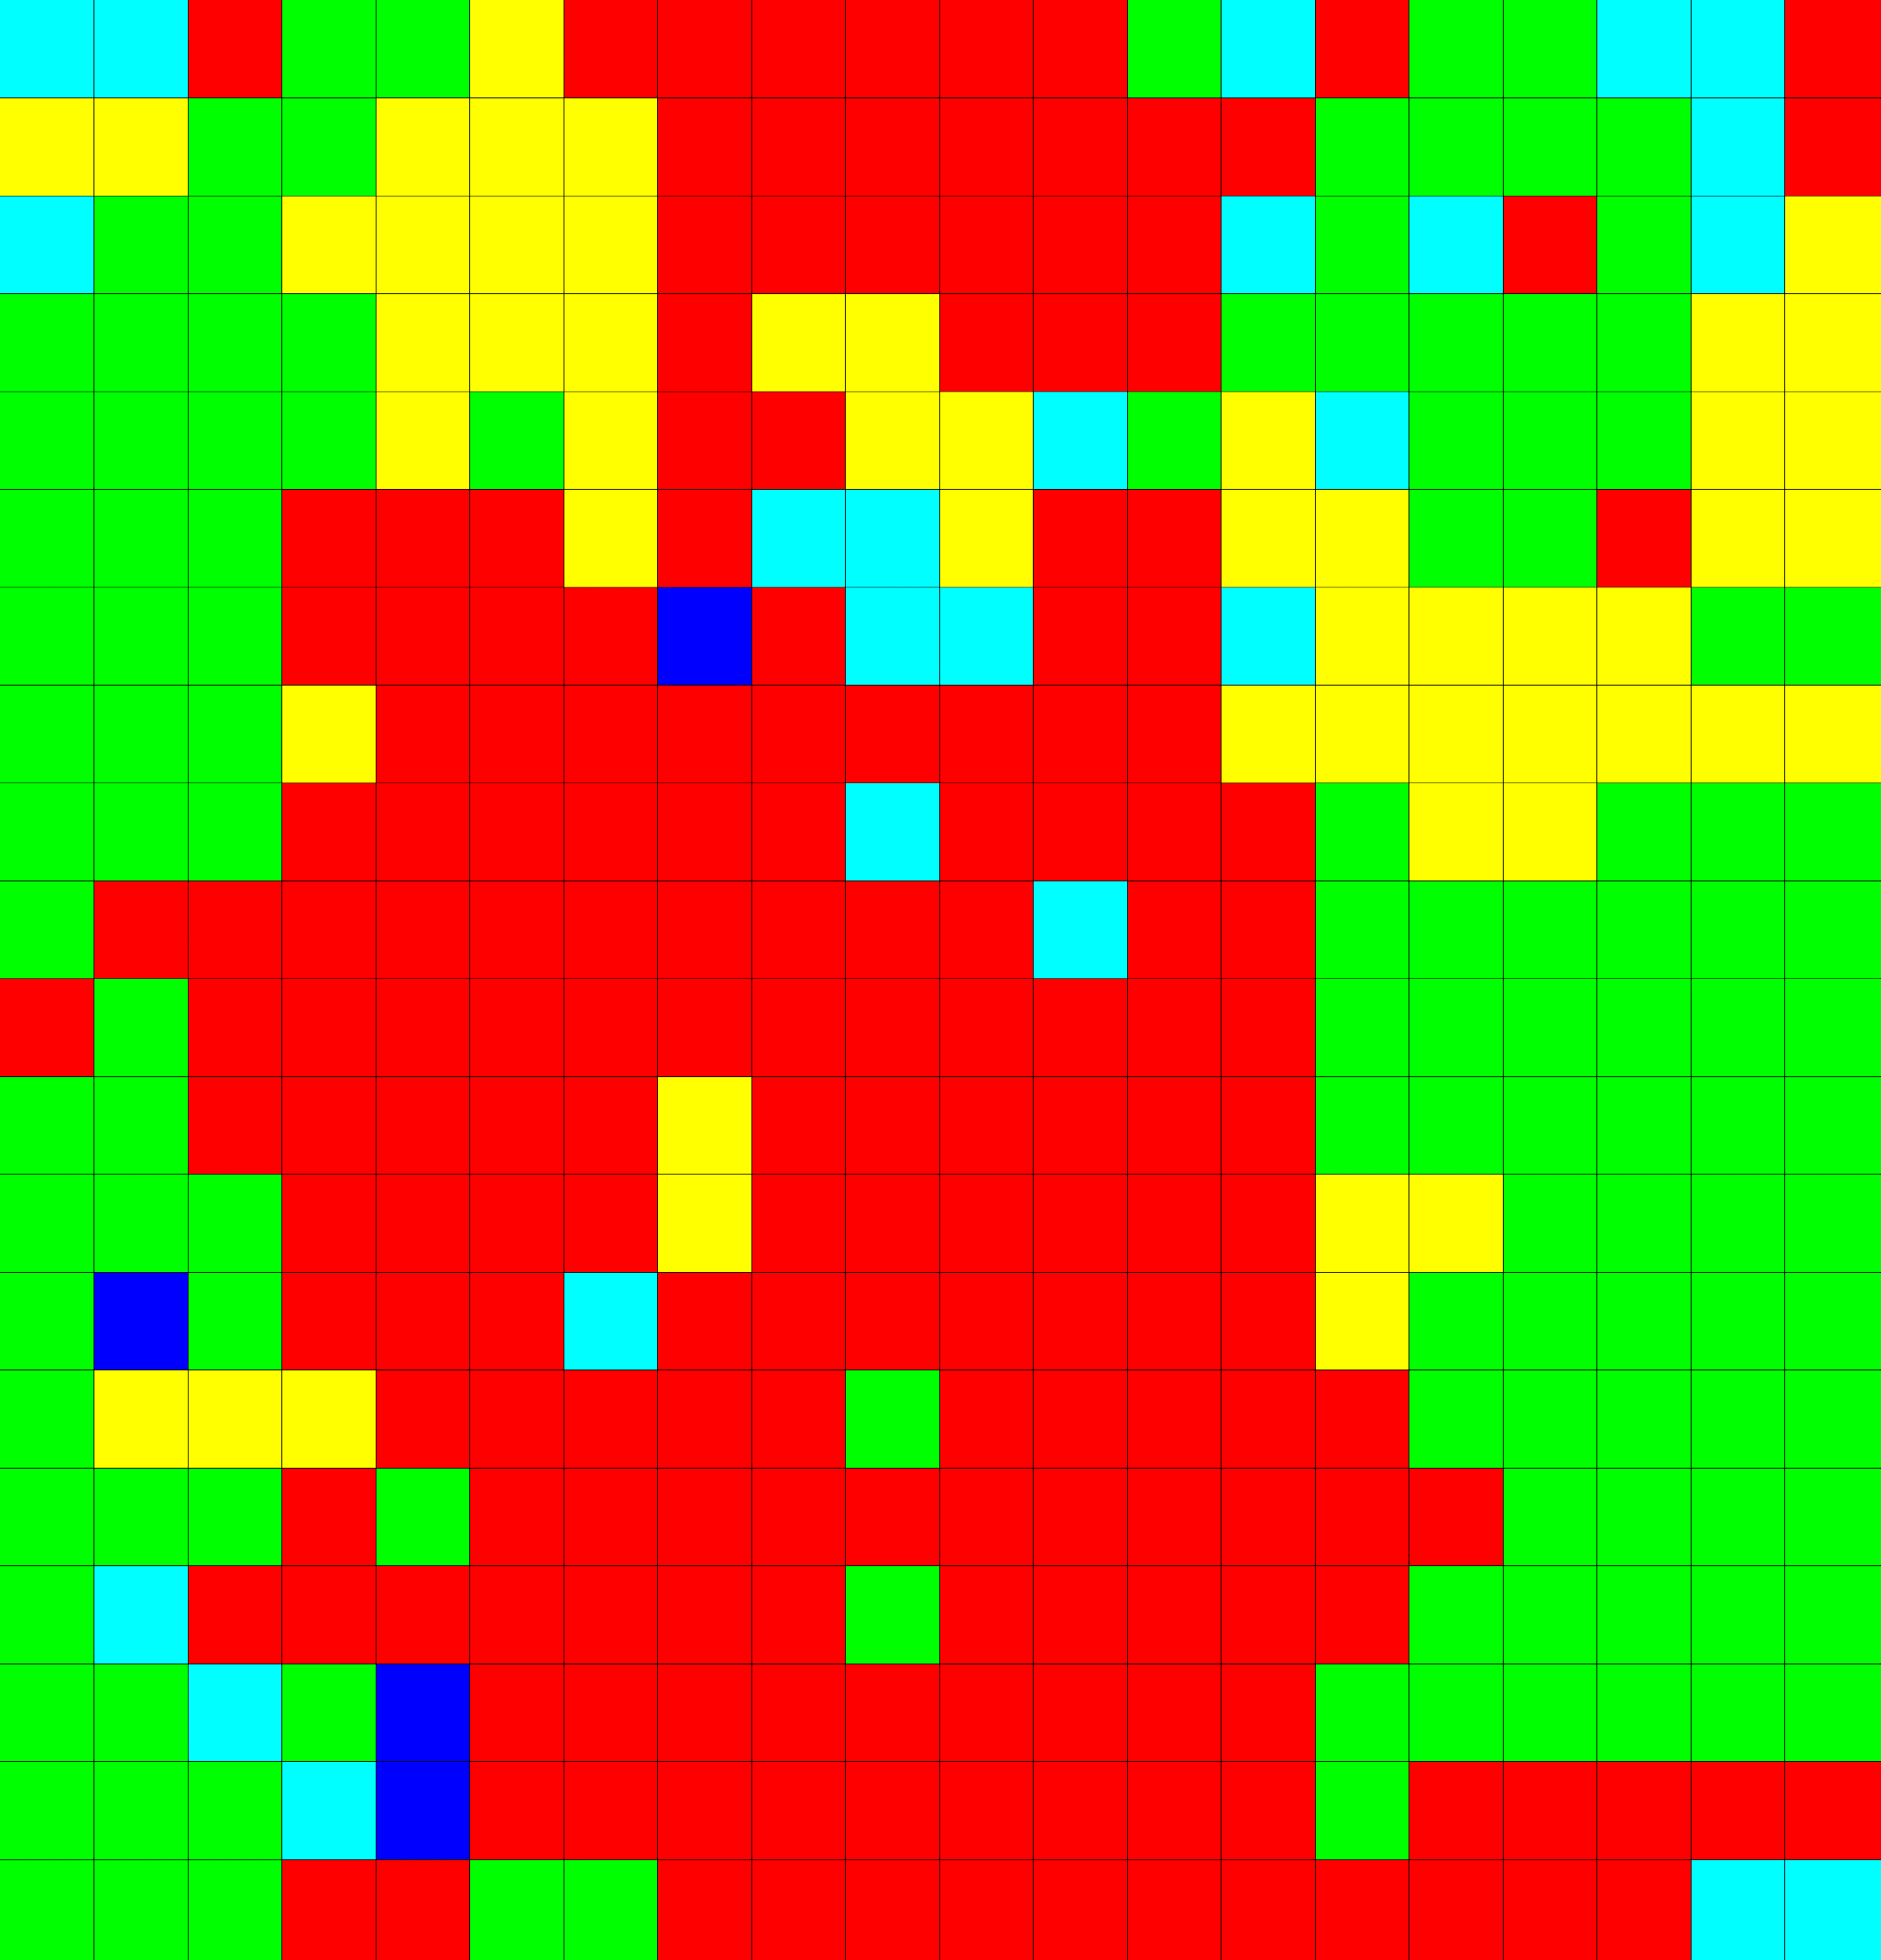
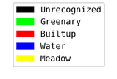
Land Use Land Cover (1 km x 1 km block)

Slide 58

Block wise Correlation (DPDC vs NTL)

Slide 59

Block wise Correlation (DPDC vs Building Categorization)

Slide 60

Block wise Correlation (DPDC vs LULC)

